Slide 1
Follow your gut!
In this talk I will be explaining briefly how your gut / digestive system reacts to stress, poor diet and lack of exercise along with some practical tips to rectify and/or improve them.

Slide 2
Quick Introduction:
My name is Emma. I have been in the health and fitness and spa industry for nearly 20 years. During the latter part of my career, I decided to move away from 5 years of management to opening my own studio offering massage, Pilates and personal training along with Nutritional help. And hopefully soon, yoga.
What I would like to share with you today is some interesting facts about your gut and brain and how we could help combat external factors like stress, poor diet and lack of exercise. If you can take one thing away from this today, I would be a very happy lady!
Please note that my remit is Personal Training, Massage, Pilates and Nutrition. So, everything I am sharing today is what I know within my area of expertise.

Slide 3
Here are a few questions to consider as we move into our first section of this talk:
In stressful situations how does your body react, how do you feel?
Have you ever had a busy day to the point where you did not have any time to eat, and you had to quickly eat your lunch at your desk or on the go. How did you feel after?
When anticipating a stressful situation, maybe it was an interview or talk in front of colleques. How did you feel?
How is your sleep pattern and eating habits at the moment i.e. Are you getting enough sleep? Are you deliberately sitting down somewhere to eat (away from any distractions). Are you taking time to eat?

Slide 4
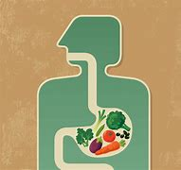
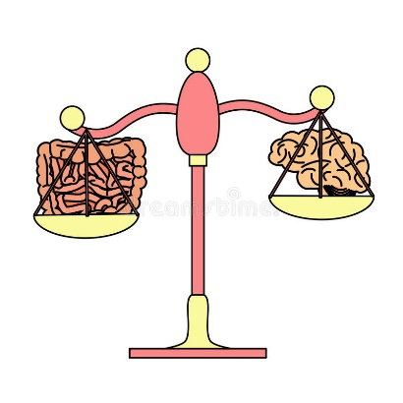
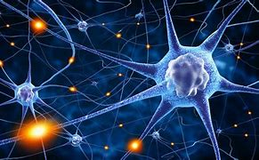
Let’s start with some fun facts:
Your food takes 6-8 hours to travel from your mouth to your small intestine. You can eat food quicker than what your stomach can digest.
You have roughly about 1.4kg of gut bacteria in your body, about the same weight as your brain!
There are around 100 million neurotransmitters in both your gut and brain. Making your gut the second brain in the body. Your gut is directly connected to your brain via the Vagus nerve

Slide 5
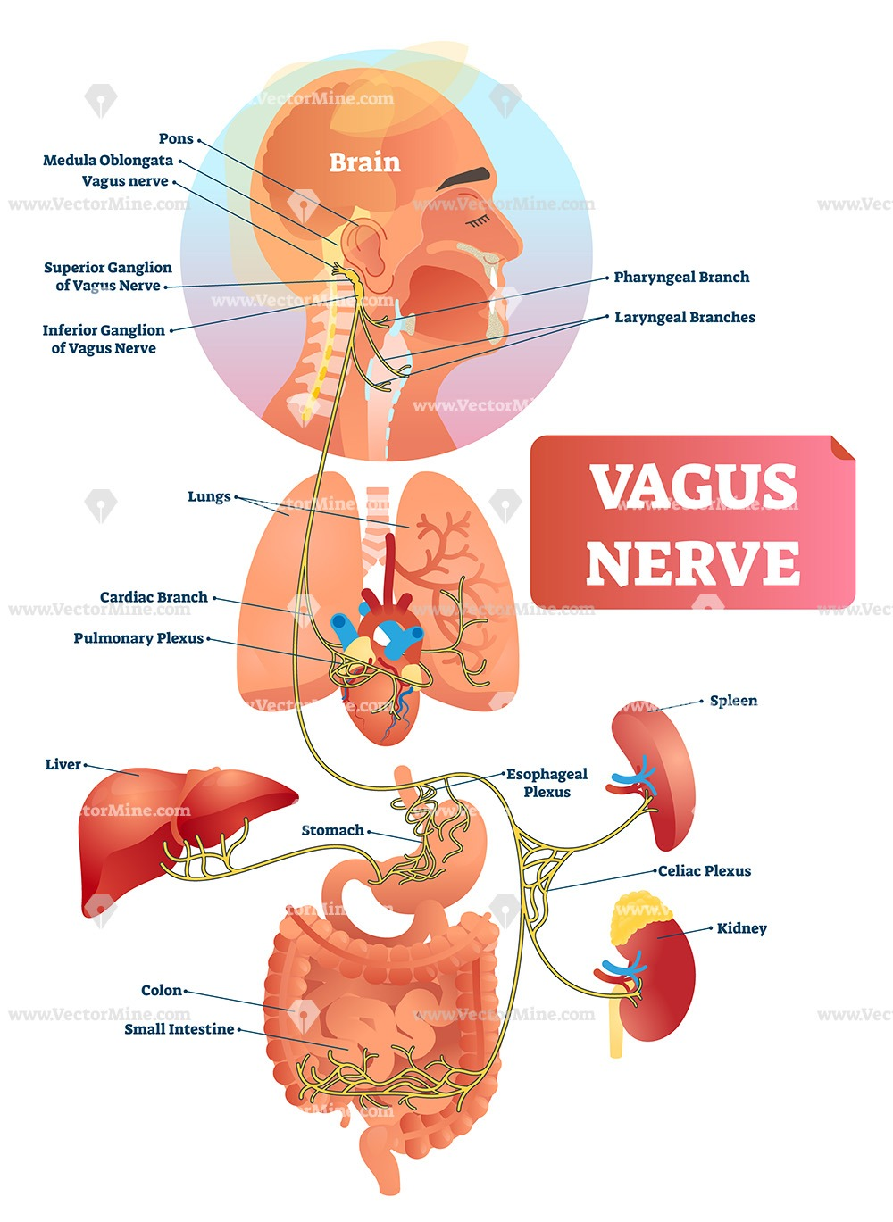

Slide 6
Stress
Fight or Flight vs. Rest and Digest
Our body is constantly in an act of balance, a bit like a seesaw. This process is known as homeostasis. When it comes to our gut, when we react to stressful situations our body will go into Fight or Flight mode (This is also known as the sympathetic nervous system). This is a primitive reaction to prepare our body to run!
The changes that occur during this process are for example:
it alerts your adrenal glands to the potential threat and they release the hormone adrenaline into your blood stream;
the adrenaline circulates around your body and triggers a number of physiological changes;
your heart beats faster pushing more blood to the muscles, heart and other vital organs so they can act quickly
your blood pressure and heart rate increase
the narrow airways to your lungs expand allowing more oxygen into your lungs more quickly
the extra oxygen is sent to your brain so you become more alert and your senses get sharper
glucose and fat is released into your blood stream providing additional energy to all parts of your body to get you ready to fight or flee.

Slide 7
*Other changes include pupils; keeps you from salivating; inhibits digestion; keeps the bladder from contracting
To balance out this process, once knowing there is no more danger, rest and digest come into play (this is known as the parasympathetic nervous system or PSNS). The opposite happens:
Constricts pupils; causes salivation; slows down the heart rate; tightens the bronchi in the lungs; enacts digestion; releases bile; makes the bladder contract.
Why is this important to know?
Basically, if our body is in constant fight or flight mode i.e.. Stress, anxiety, lack of sleep etc. Our digestive system cannot function to it full potential.
Simple things such as saliva production during chewing and excretion is decreased. As well as bile release from your liver and the gall bladder is decreased. Therefore, food cannot be digested properly and broken down into the right size for absorption of vitamins and minerals.
This is why we loose apatite sometimes when we are stressed or have stomach cramps if we try to eat.

Slide 8
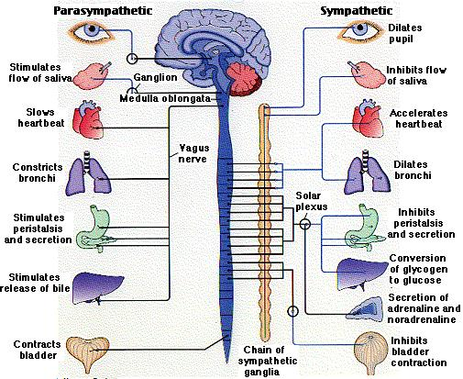

Slide 9
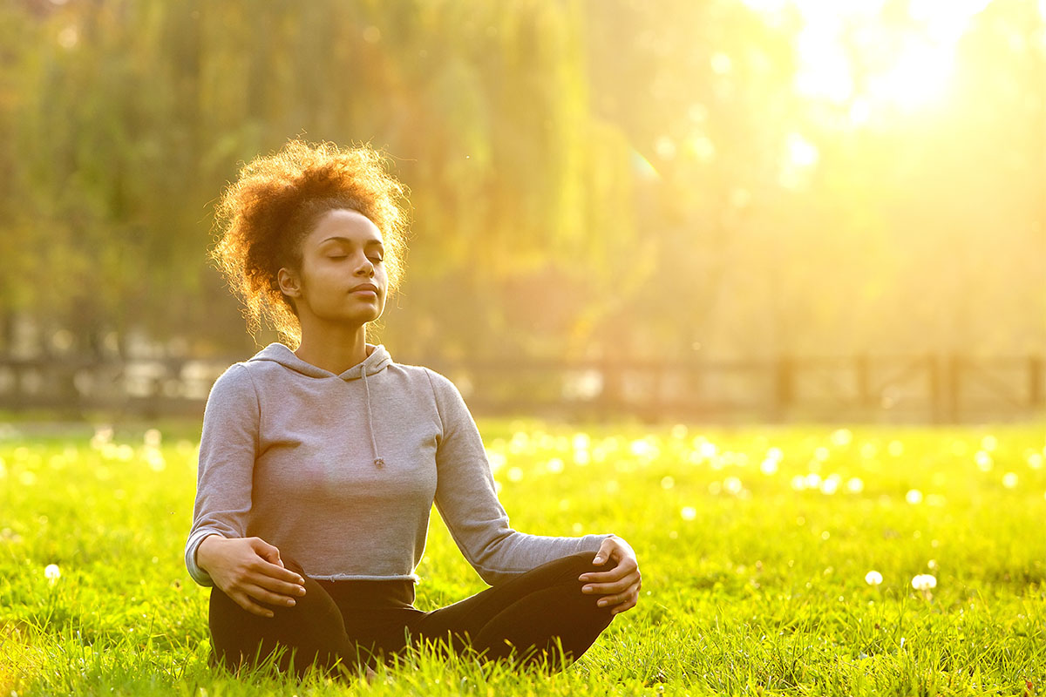
Let’s look at some ways we can reduce or combat the above:
Breathing and mindfulness:

Slide 10
Deep belly breathing and mindfulness exercises can help reduce stress levels
Controlled breathing, often called breathwork, is also very effective for pain management and helps with many other maladies, like stress, anxiety, insomnia, post-traumatic stress disorder, depression, attention deficit disorder and high blood pressure, to name a few.
Breathwork helps boost the immune system, increase alertness, and improve vitality.
Studies demonstrate that breathwork can lower levels of three cytokines that are associated with inflammation and stress. Consciously changing our breath patterns sends a signal to the brain to adjust the nervous system and slow heart rate and digestion. ( Parasympathetic nervous system)
Let’s give it a go…

Slide 11
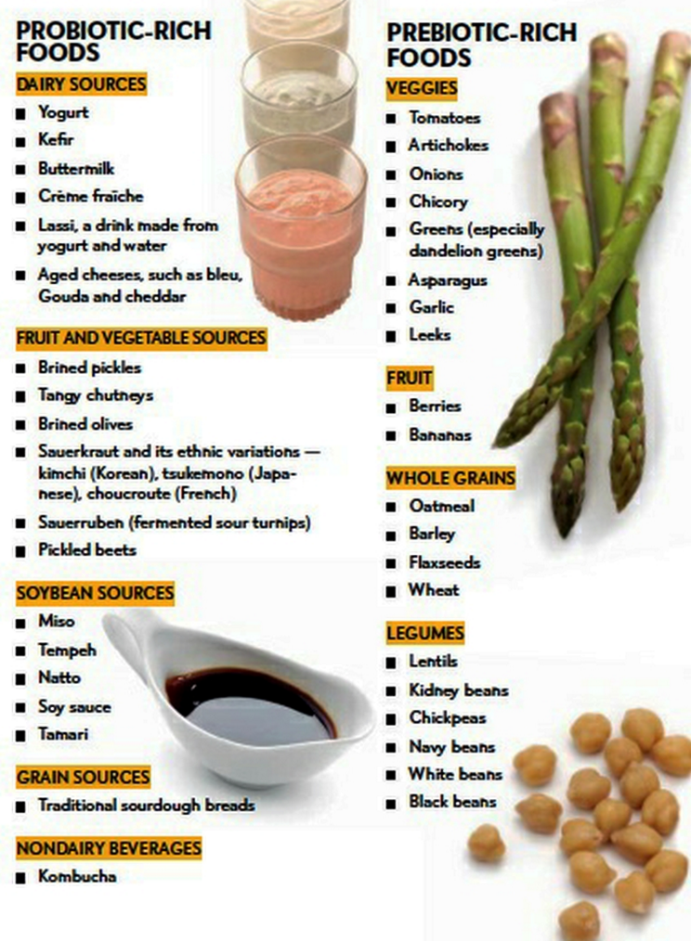
Diet
In order for your gut to function at it’s optimal, you need to feed it right.
First up are pre and pro – biotics.
Think of pro-biotics supplying the gut with good bacteria and pre-biotics as food for gut bacteria.
Both should be taken daily - It is recommended that if you introduce new sources gradually and in small portions.
Side effects can be bloating, and discomfort. Make sure you take extra care if you have history of IBS or any other gut related symptoms. I would recommend you check with your GP before making any major changes.

Slide 12
Other dietary changes to consider:
Also try to reduce sugar intake especially refined sugar. According to the NHS guidelines; Adults should have no more than 30g of free sugars a day, (roughly equivalent to 7 sugar cubes). For example:
120g of Carrot cake = 10.5 tsp of sugar (42g of sugar)
85g Blueberry Muffin = 5.5tsp of sugar (22g)
1pint of sweet cider = 6tsp of sugar (24g)
200g portion of baked beans = 2.5tsp (6.25g)
2. Eat more fibre (Pre-biotic foods where possible)
We should consume around 30g of fibre each day. Note that fibre does not count as a carbohydrate.
The job of Fibre or prebiotic foods is to feed the good bacteria in the gut.

Slide 13
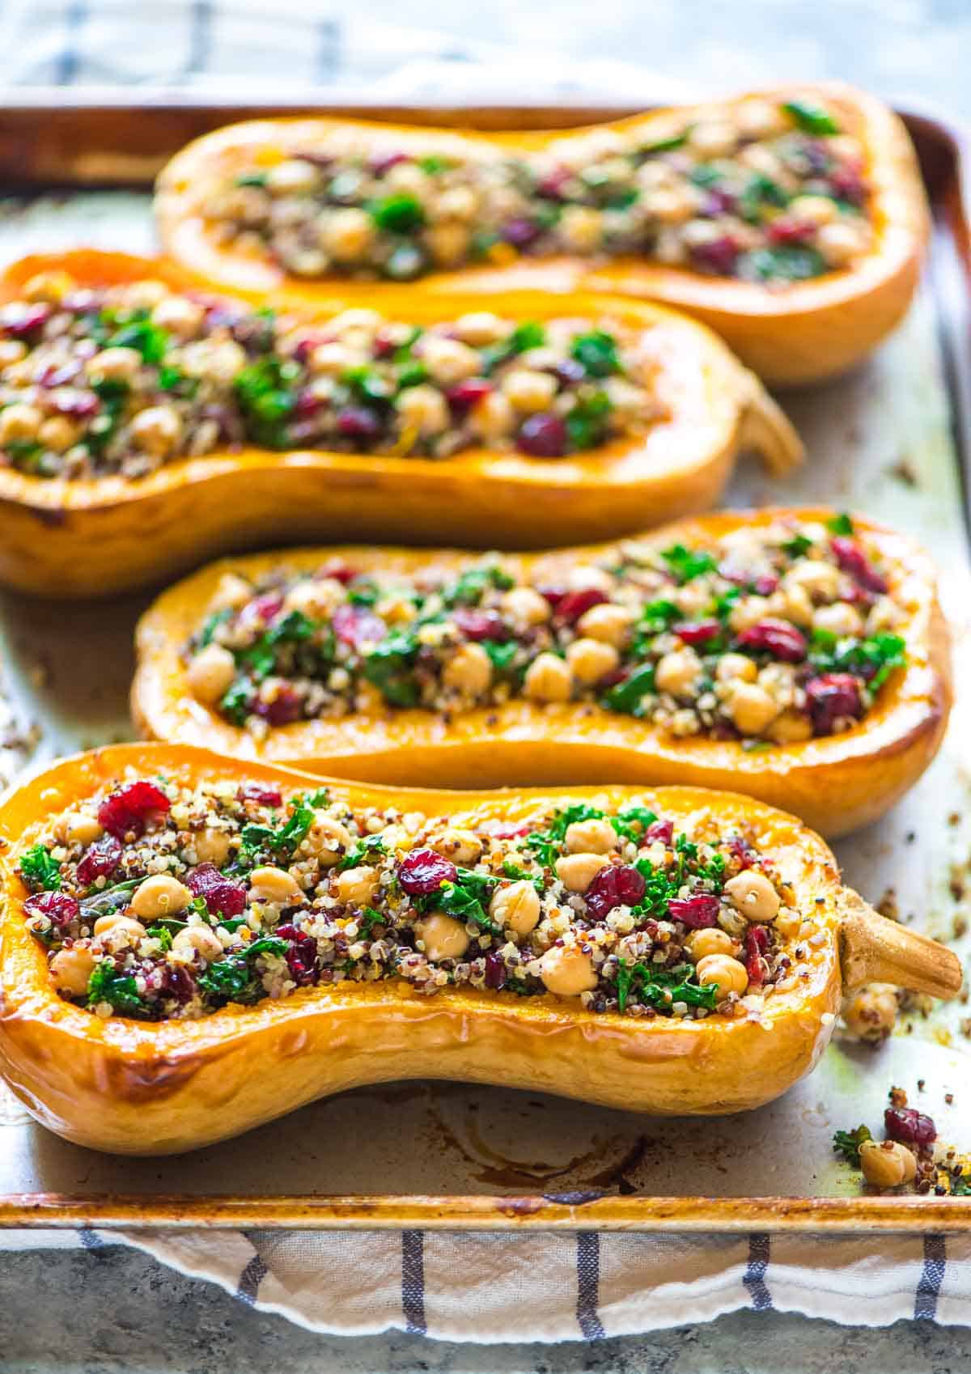
Take a minute and look at this picture, maybe think of your favourite meal. What is starting to happen?
*Thoughts (brain)
*Salivating?
*Hunger?
3. Finally take your time when you eat, chew your food longer. These basic tips (which we all know) is fundamental in helping the body to produce saliva and other enzymes that starts to breakdown food from the point of entering the month all the way down to the small intestines where vitamin and mineral absorption happens.

Slide 14
Exercise
Exercise can consist of many elements. It could vary from strength work, endurance and cardio to stretching/flexibility.
The key here is to do something every day. It is recommended to do 5 x 30min light cardio session weekly. This could be a brisk walk or a gentle bike ride or swim.
When it comes to exercising it is a very personal thing and everyone benefit differently from different aspects of it. The key is to get moving.
Exercise raises your heart and breathing rate, which in turn stimulates the waves of muscle contractions that move stools through the gut – a process called peristalsis. This helps the gut operate more efficiently, which means food spends a shorter time in the bowel. In turn, this means less water is absorbed back into the body via the small intestine – keeping the stools soft.
In a 2014 study published in World Journal of Gastroenterology, researchers asked inactive patients in a psychiatric hospital to exercise for 60 minutes three times a week for three months. The results found that for the exercising patients, food spent around 30 hours in the bowel, compared to 54 hours for the control group.

Slide 15
Video and web resources used for this talk.
Your gut and brain.
1.https://youtu.be/awtmTJW9ic8
2.Healthy Digestion - Not What, But How? | Courtney Jackson | TEDxMontrealWomen - Bing video
Exercise for your gut
3. Why You Should Exercise for a Healthy Gut | Holland & Barrett (hollandandbarrett.com)
Breathing techniques
4. Ujjayi Breathing | Yoga with Adriene - Bing video
Yoga Breathing | Alternate Nostril Breathing - Bing video
How much sugar?
How much sugar is in different foods? (bhf.org.uk)

